Slide 1
Identifying Underserved Locations in the Event of a Crisis
Creators: Paul Giesting, Erik Janer, Rajkumar Katta, Natalie Paley, Nicole Semerano

Slide 2
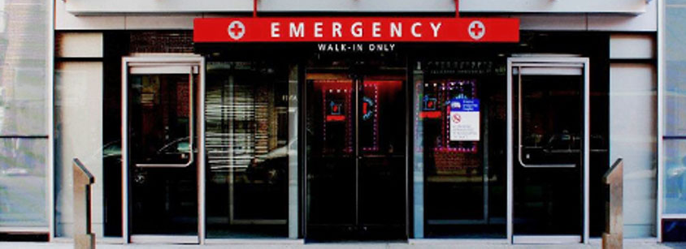
Problem Statement
People need to be able to get to hospitals in the case of an emergency.
We found the busiest subway stations and paired them with their distance to hospitals.
Those which are furthest from a hospital may need the greatest resources in the event of a disaster.
Notes:
Nicole

Slide 3
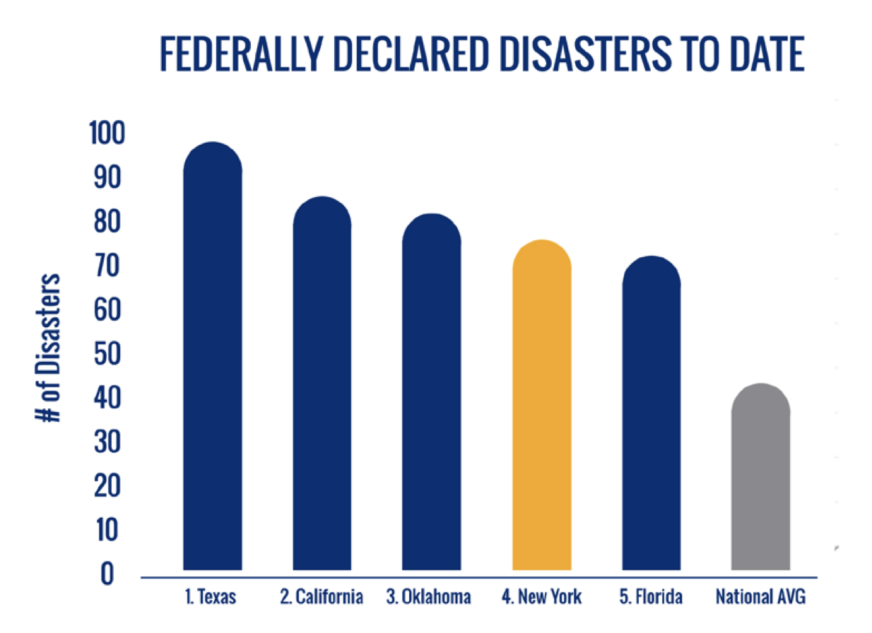
End User
NYS Disaster Preparedness Commission (DPC)
NYS Comprehensive Emergency Management Plan
Long-Term Recovery Plan
NYC Emergency Management Department
Private Hospital Organizations
Notes:
Nicole
Private Hospital Organizations--Columbia Pres., Mt. Sinai, NYU
NYC EMD--respond to big (current, summer blackout) and small(NYC marathon)
CEMP: Multi-Hazard Mitigation Plan---reduce loss of life and property by reducing the impact of disasters

Slide 4
Data Gathering, Joining, and Cleanup
Transparent Government Sources:
National Hospital list - HIFLD - winnowed down to NYC
MTA Location Data - NYC Open Data
MTA Daily Usage - MTA
Notes:
Paul & Erik
HIFLD - Homeland Infrastructure Foundation Level Data
Geopy to find distances, create a lookup table between location & turnstile data, clean up duplicates
Mention that Paul will be back to discuss distance data

Slide 5
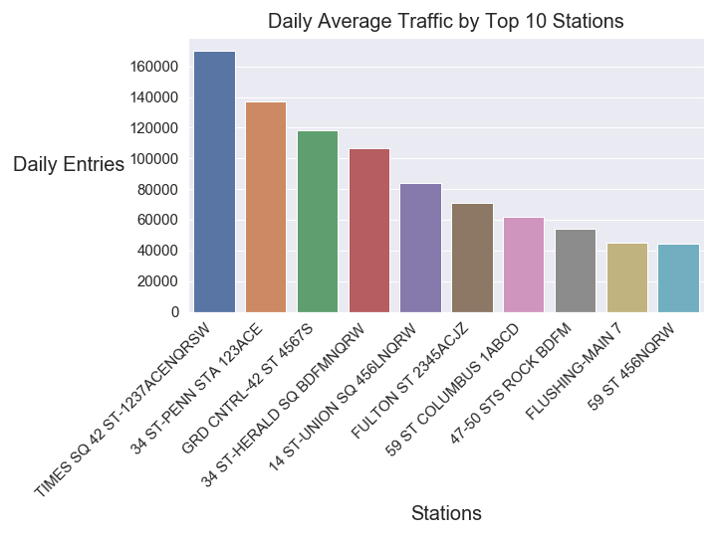
Average Daily Entries for Top Stations
Notes:
Erik

Slide 6
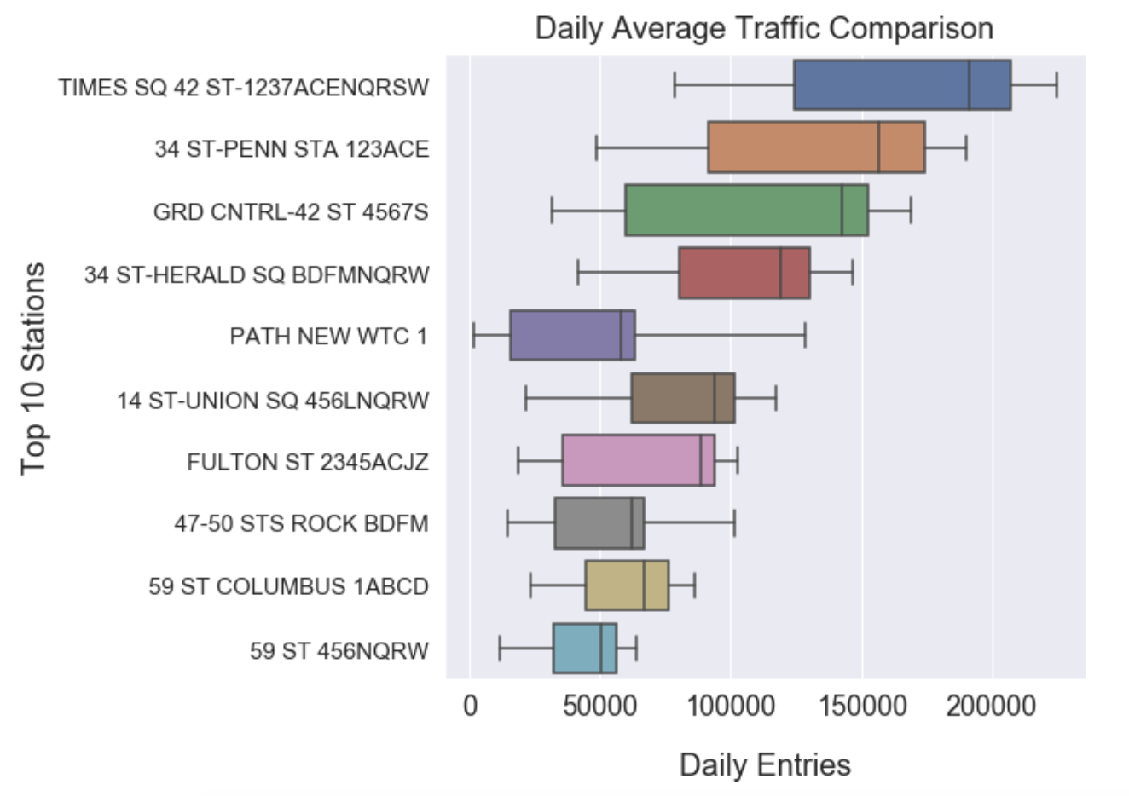
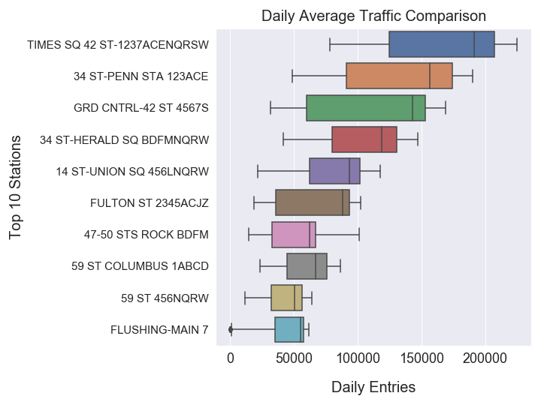
Busiest Stations
Notes:
Raj

Slide 7
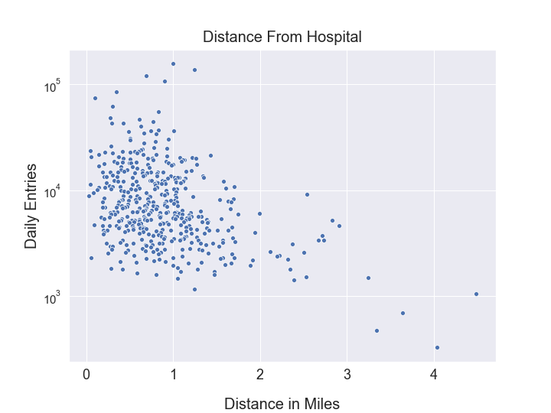
Stations and Distance to Nearest Hospital
Notes:
Raj

Slide 8
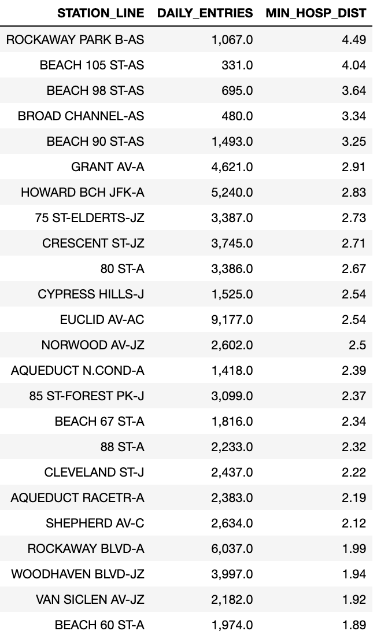
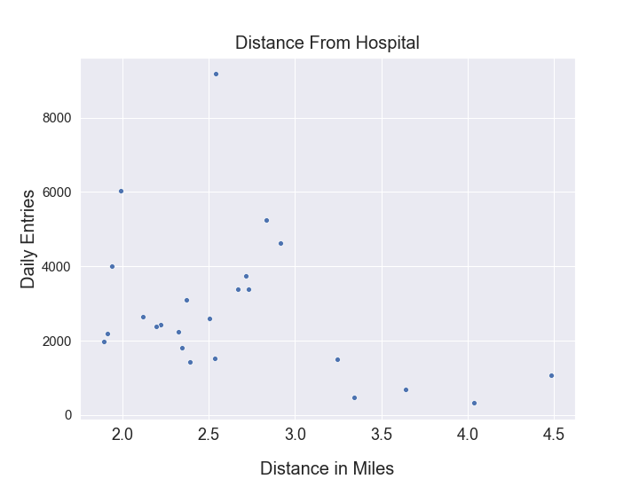
Station Points of Interest
Notes:
Paul
Notes: blue is Rockaway. Gold is adjacent to JFK. Red is adjoining regions of southeast Brooklyn. All these areas are in southeast Brooklyn / Rockaway.
This may be a really underserved area that deserves more study and intervention.

Slide 9
Extensions and Refinements
Notes:
Natalie

Slide 10
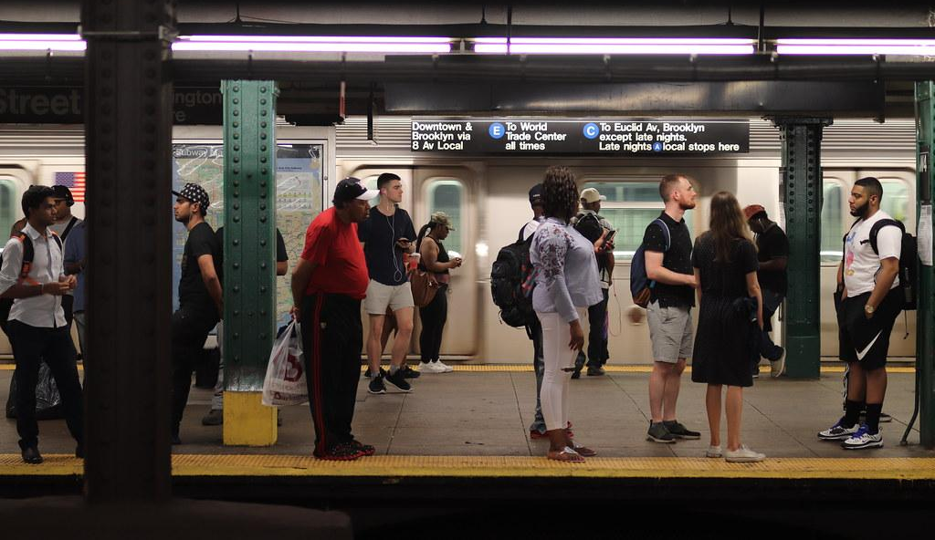
Narrow in on Commuters
Commuter usage:
Filter out big event dates
Use commuter hours
Use March and forward data
Notes:
6-8 pm or 6-8 am

Slide 11
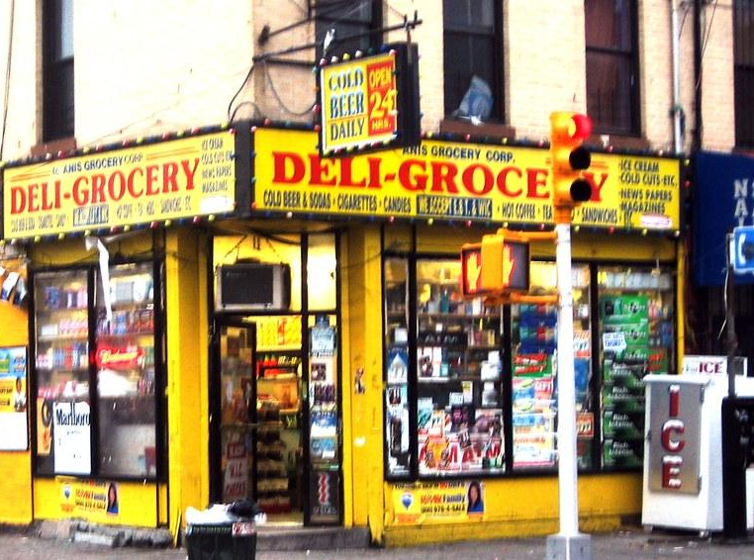
Additional Data Sources
Doctor’s Offices
Grocery Stores
Fire Departments
Airports / Bus lines

Slide 12
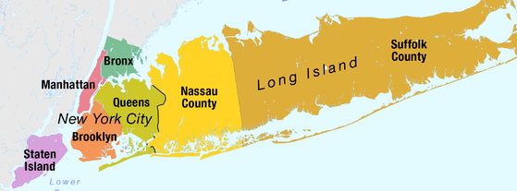
Localizing
Dividing locations to expand potential end users:
Borough Presidents
Community Board Leaders
City Council
Notes:
Borough, zip code

Slide 13
Additional Informational Slides

Slide 14
Data Cleaning
Removed all RECOVR AUD entries
Turnstile resets
Popular event dates?
Extensions:
Popular event dates?

Slide 15
Sources and Resources
Data Sources
http://web.mta.info/developers/turnstile.html
https://hifld-geoplatform.opendata.arcgis.com/datasets/hospitals/
http://www.dhses.ny.gov/media/documents/emergency-management-for-elected-officials.pdf
Python Resources
Geopy

Slide 16
Group Notes DELETE
End User - Local CDC, Health Department
Find busiest entry in morning hours and exit points (MVP
Hospital distance from station
Scatter Plot at this point
3rd remove/add transit hubs
Split by months
Station data
Lat and Long of both stations and
10th of a mile can be used as a distance
Geo py
Notes:
“Skip slide” makes this one invisible

